Slide 1
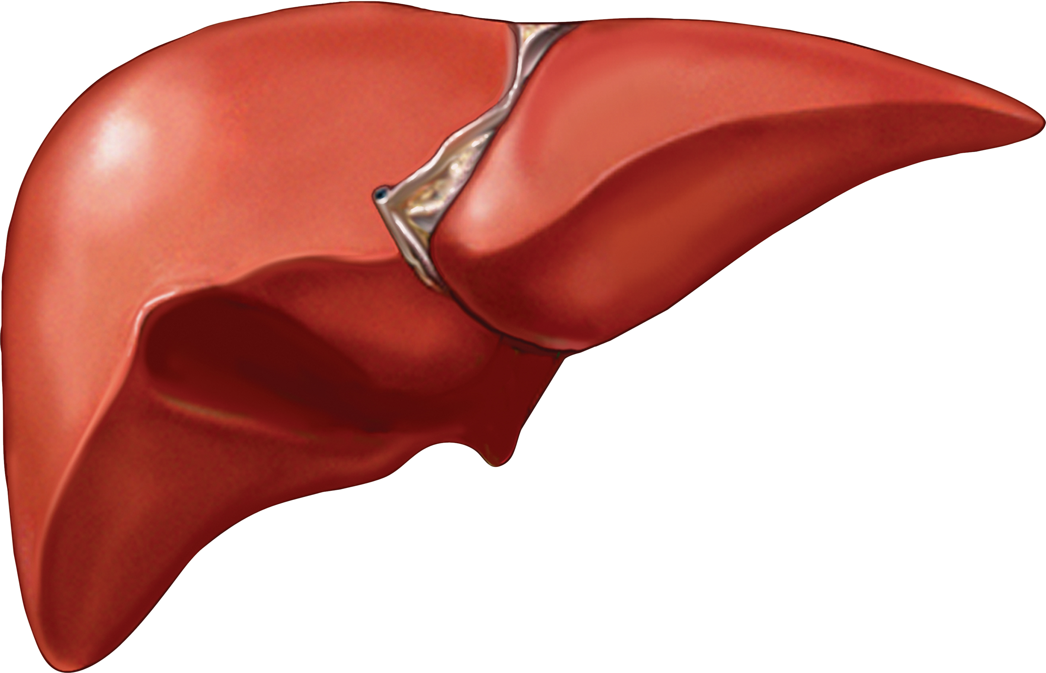
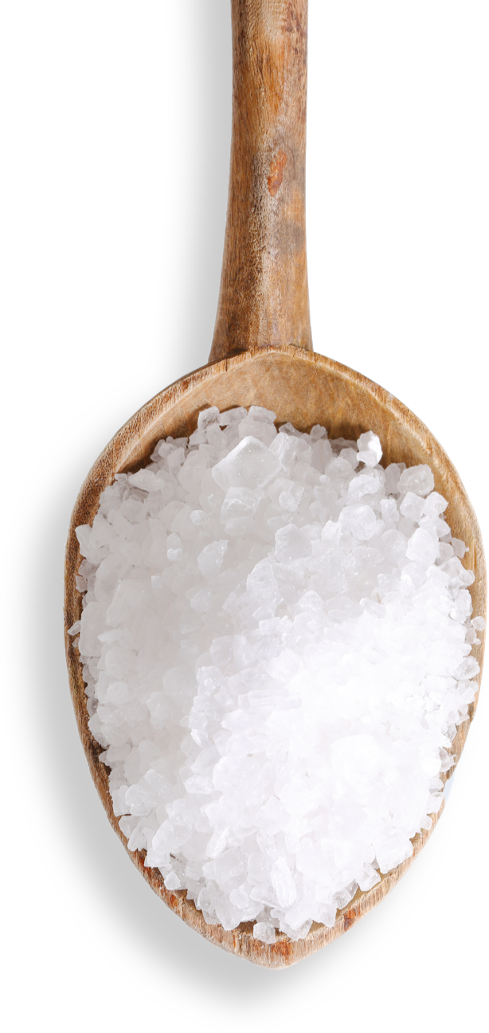


Hyponatremia in Liver Transplantation
Mohammad Almeqdadi, MD
Transplant Hepatology Fellow, PGY-7

Slide 2
Outline
Pathophysiology of hyponatremia in cirrhosis
Importance in prognostications
Treatment of hyponatremia and challenges
Hyponatremia in liver transplantation
Osmotic demyelination syndrome
Take-home points

Slide 3
Hyponatremia in Cirrhosis
Normal Na is 135-145 mEq/L
Hyponatremia is a common complication in patients with cirrhosis.
The pathogenesis of hyponatremia in cirrhosis is associated with hemodynamic changes and secondary neurohumoral adaptations.
Mainly a result of water retention
The severity of hyponatremia is directly related to the severity of cirrhosis (MELD-Na)

Slide 4
Pathophysiology

Slide 5
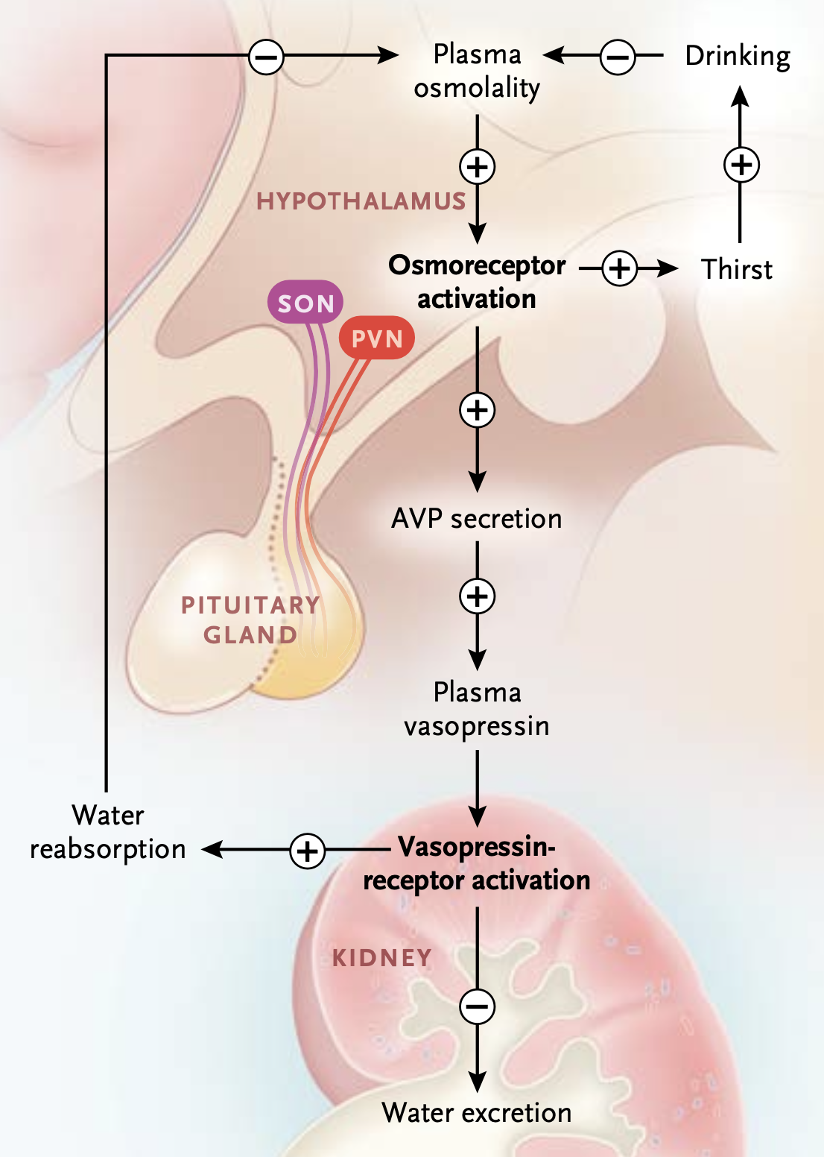
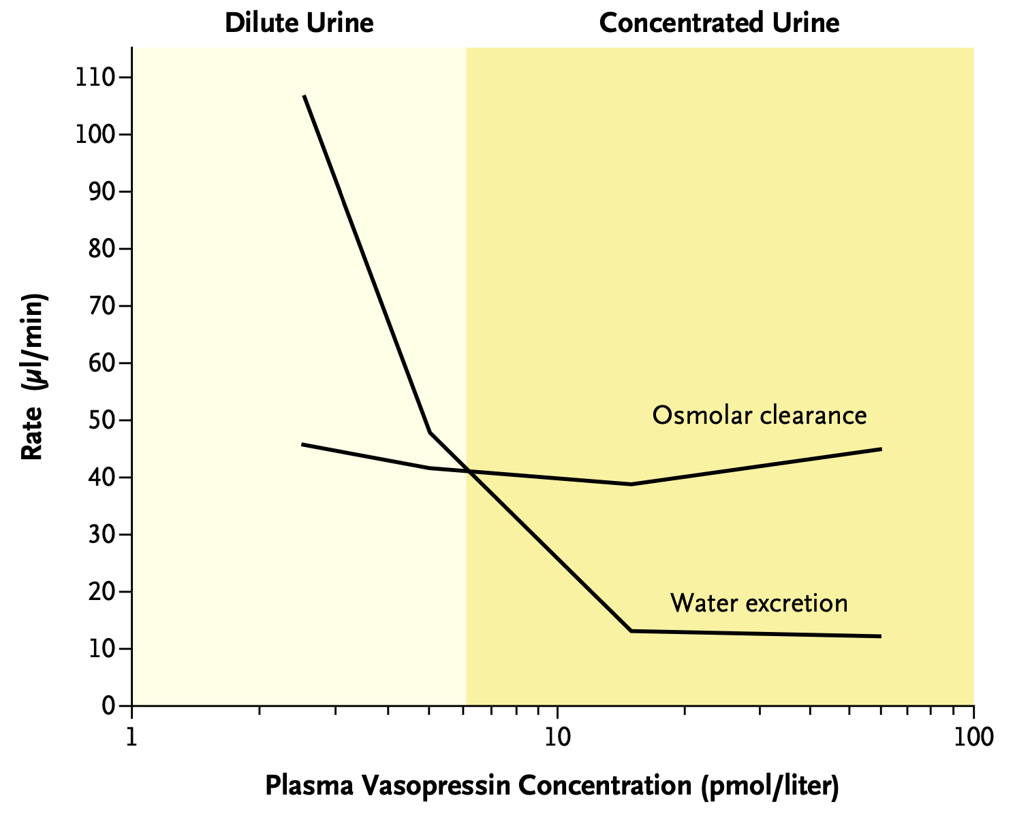
Knepper MA, Kwon TH, Nielsen S. Molecular physiology of water balance. N Engl J Med. 2015 Apr 2;372(14):1349-58

Slide 6
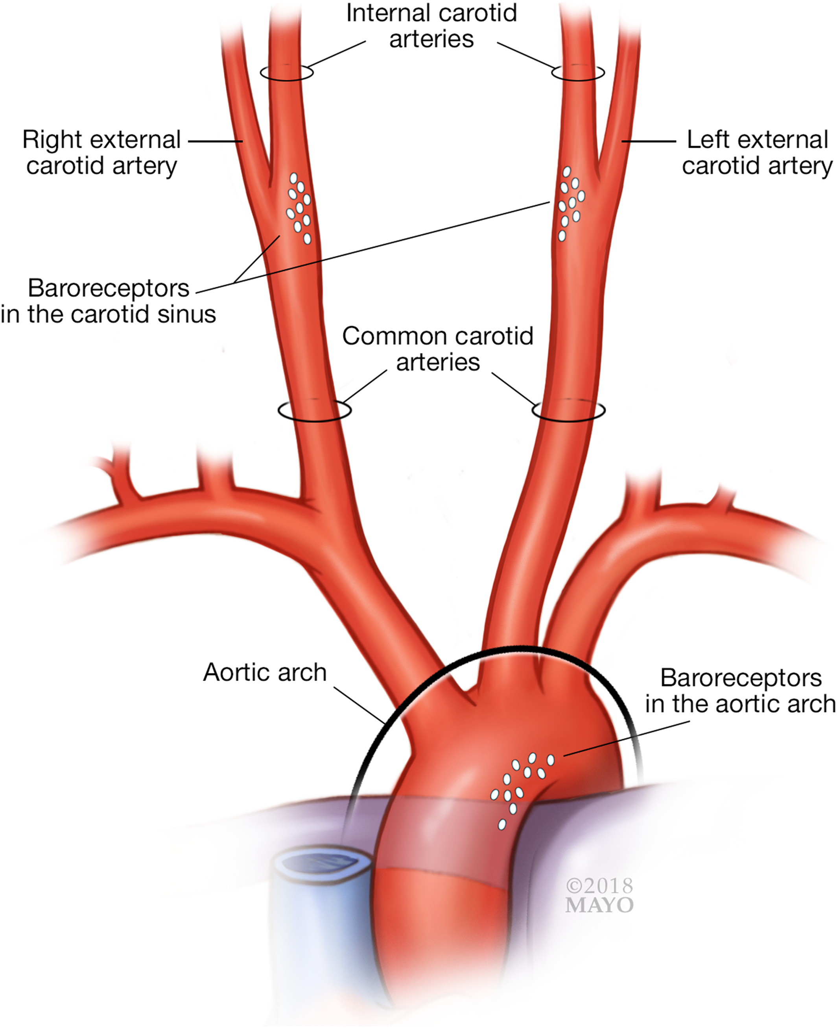
Non-osmotic
activation
+
Knepper MA, Kwon TH, Nielsen S. Molecular physiology of water balance. N Engl J Med. 2015 Apr 2;372(14):1349-58

Slide 7
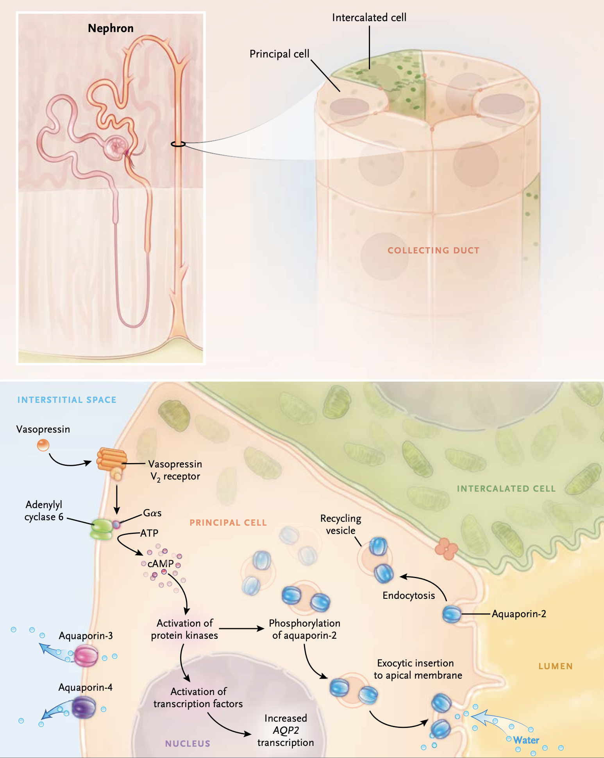
Knepper MA, Kwon TH, Nielsen S. Molecular physiology of water balance. N Engl J Med. 2015 Apr 2;372(14):1349-58

Slide 8
So what happens in cirrhosis?

Slide 9
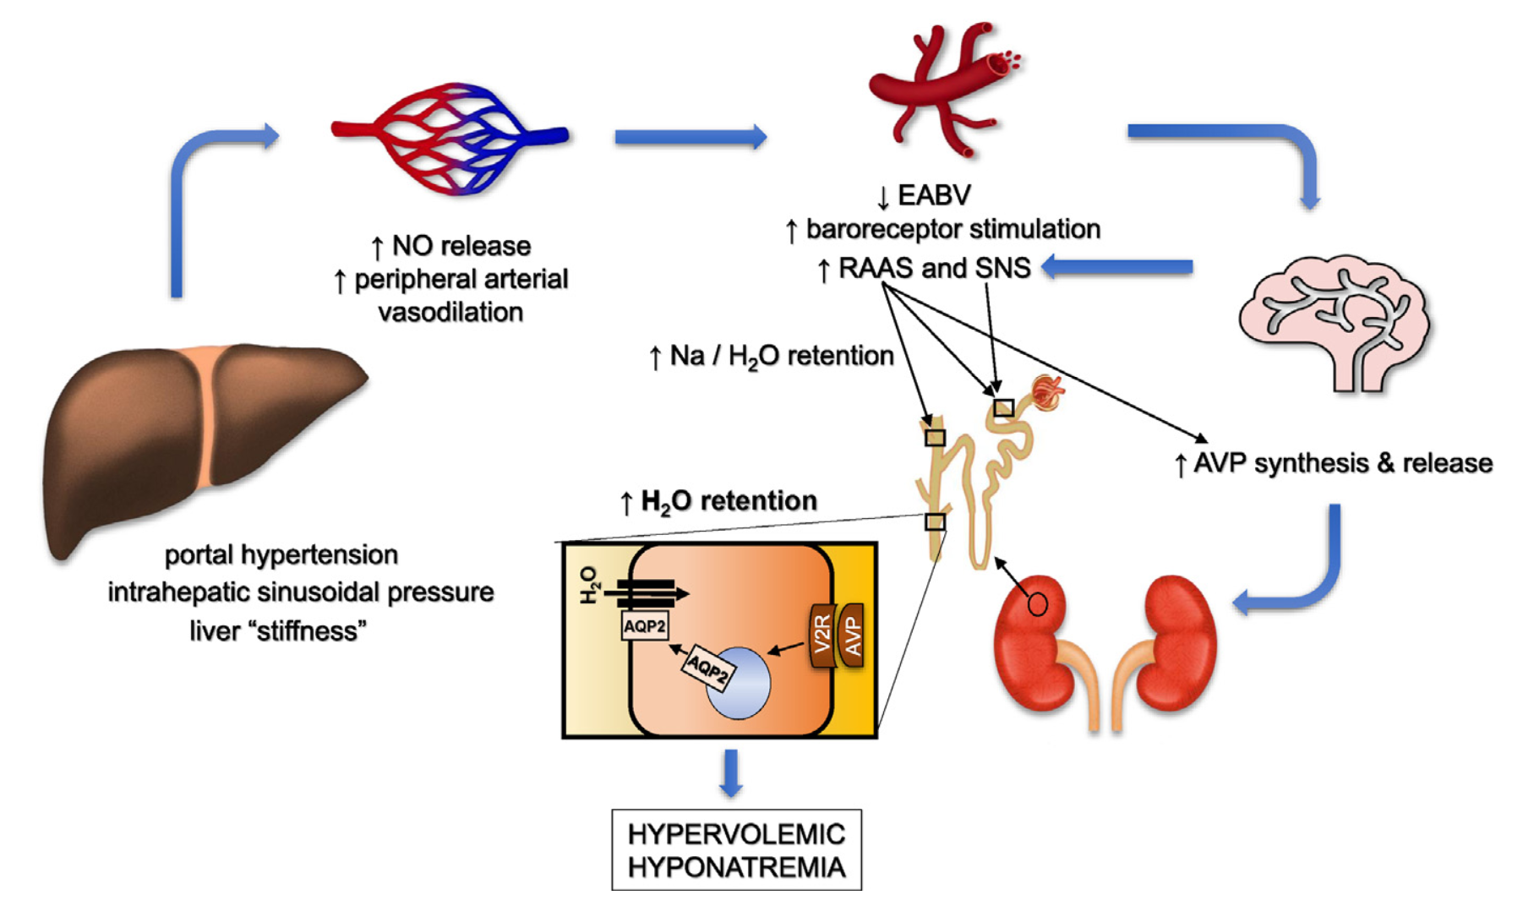
Rondon-Berrios H, Velez JCQ. Hyponatremia in Cirrhosis. Clin Liver Dis. 2022 May;26(2):149-164

Slide 10
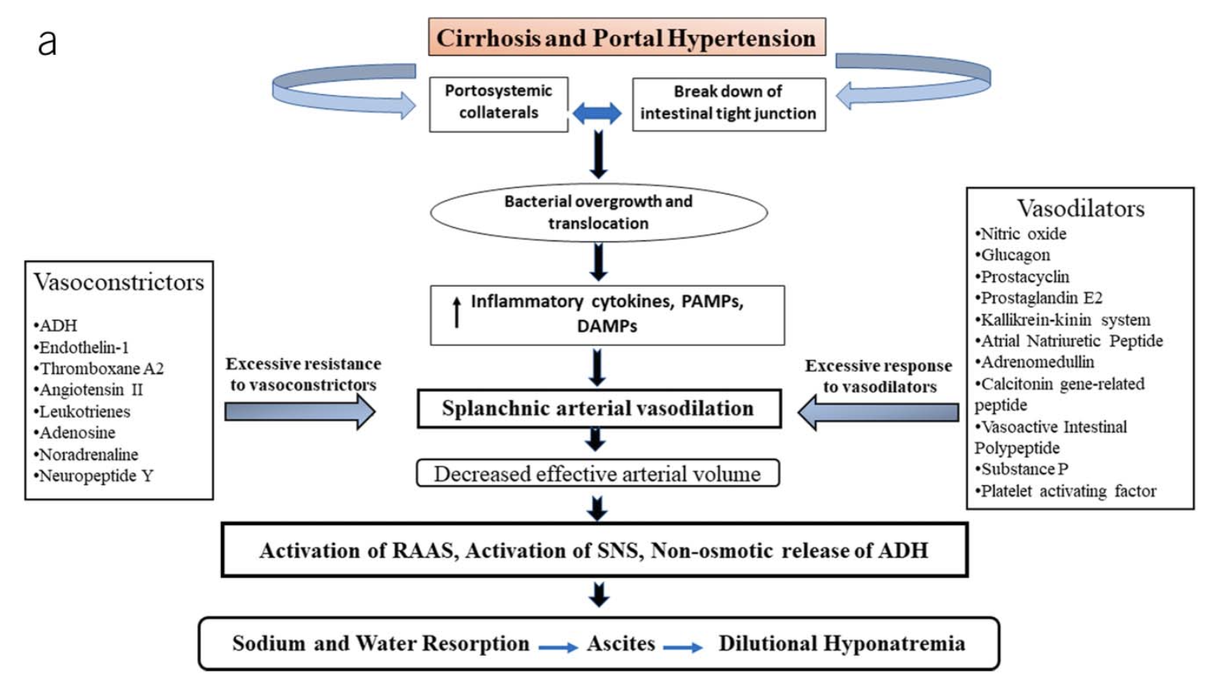
Alukal JJ, John S, Thuluvath PJ. Hyponatremia in Cirrhosis: An Update. Am J Gastroenterol. 2020 Nov;115(11):1775-1785

Slide 11
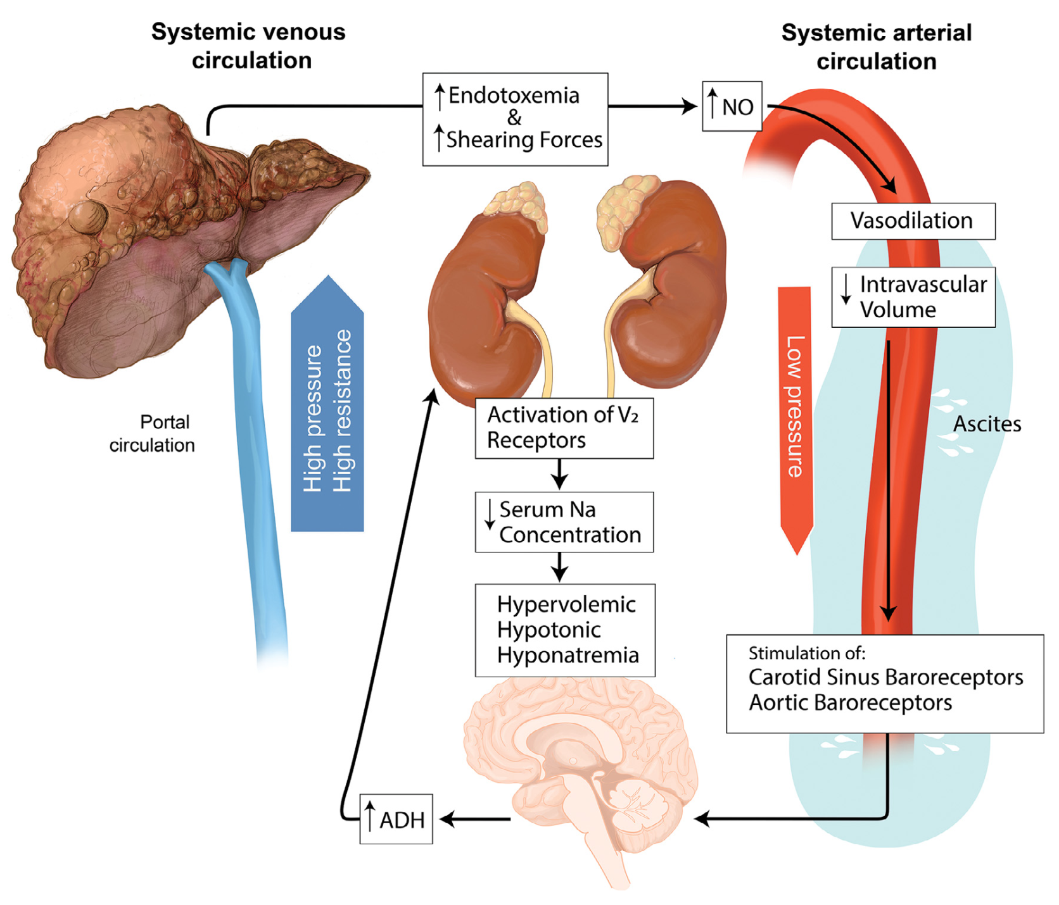
Verbeek TA, Saner FH, Bezinover D. Hyponatremia and Liver Transplantation: A Narrative Review. J Cardiothorac Vasc Anesth. 2022 May;36(5):1458-1466

Slide 12
Pathogenesis of Hyponatremia in Cirrhosis
Systemic vasodilation <- NO/Endotoxins
Iatrogenic factors <- diuretics/NSBB/LVP
AVP/ADH activation -> water retention
  Direct activation <- baroreceptors under-stretch (hypotension)
  Indirect activation <- RAAS activation (low effective volume)

Slide 13
Hyponatremia in Cirrhosis and Prognostications

Slide 14
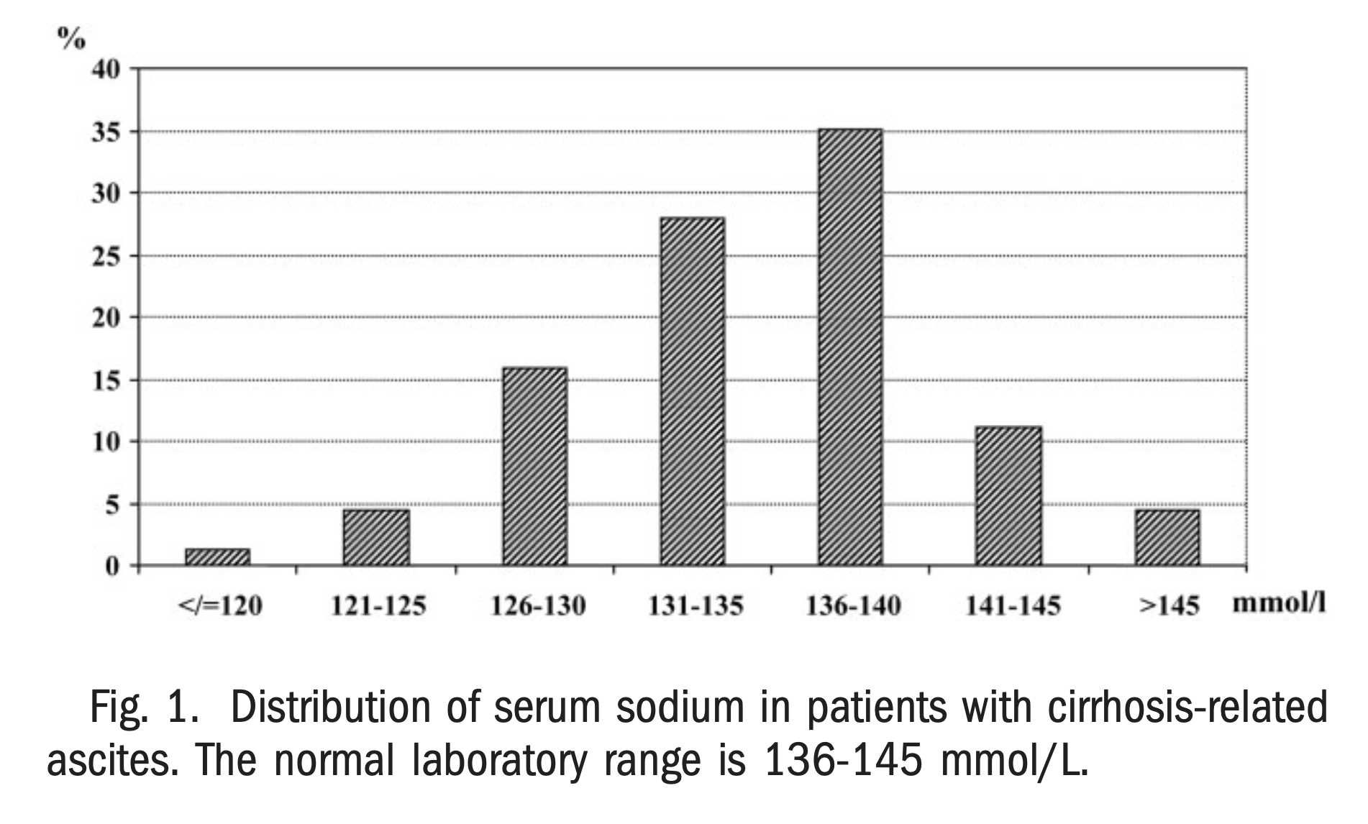
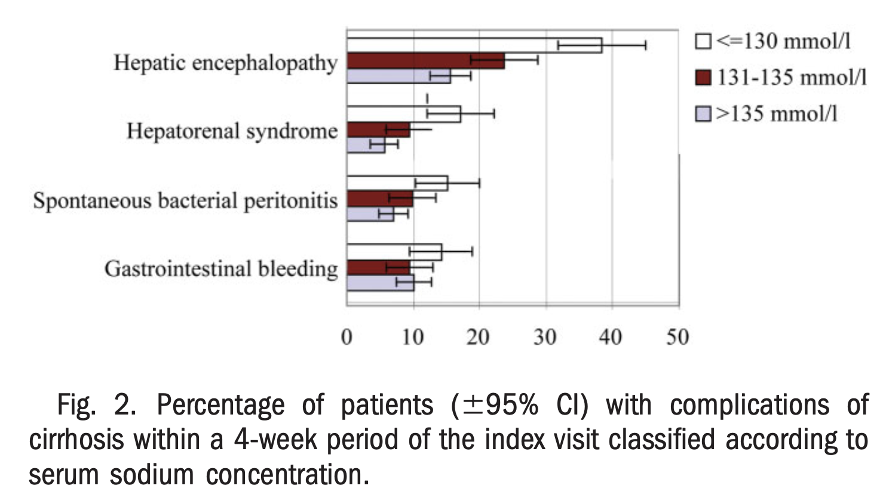
Angeli P, Wong F, Watson H, Ginès P; CAPPS Investigators. Hyponatremia in cirrhosis: Results of a patient population survey. Hepatology. 2006 Dec;44(6):1535-42

Slide 15
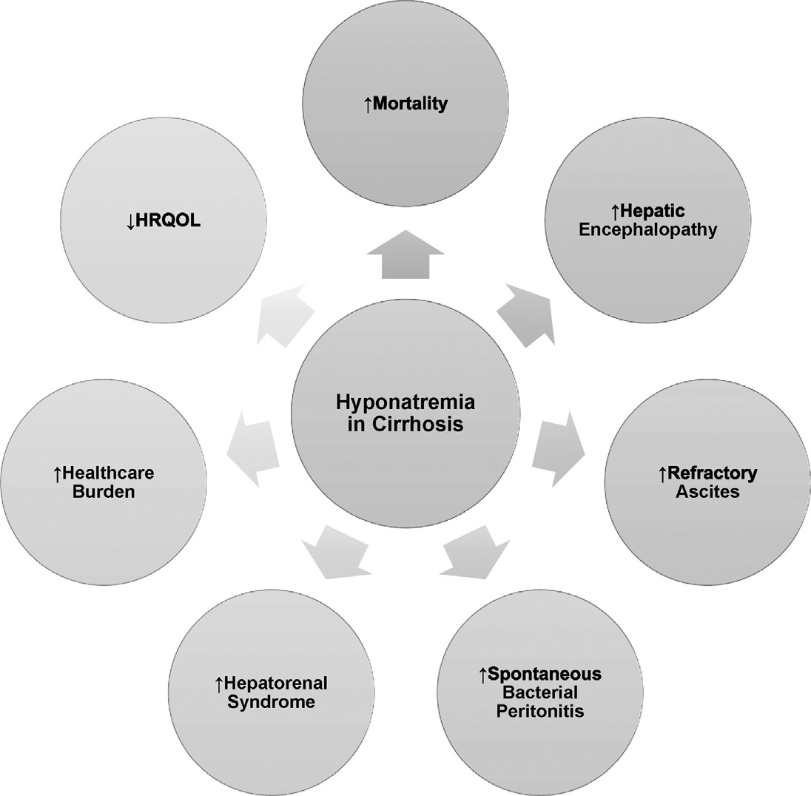
Rondon-Berrios H, Velez JCQ. Hyponatremia in Cirrhosis. Clin Liver Dis. 2022 May;26(2):149-164

Slide 16
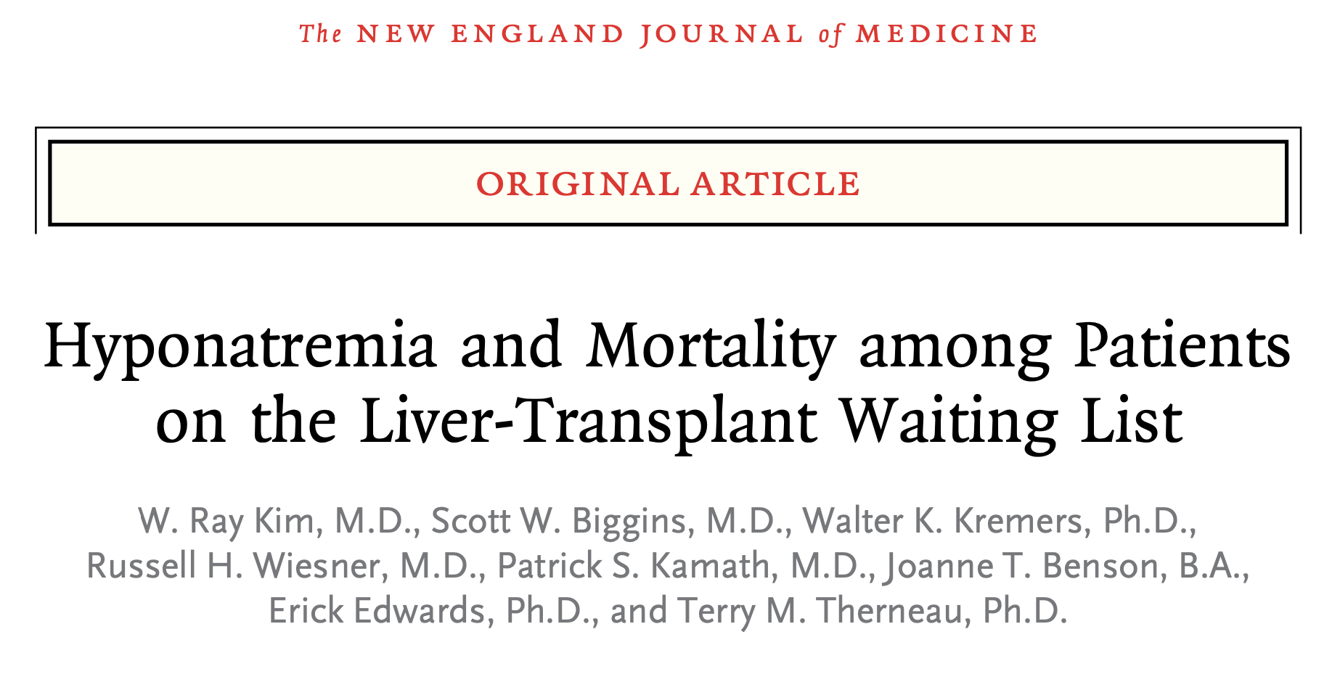

N Engl J Med 2008;359:1018-26.

Slide 17
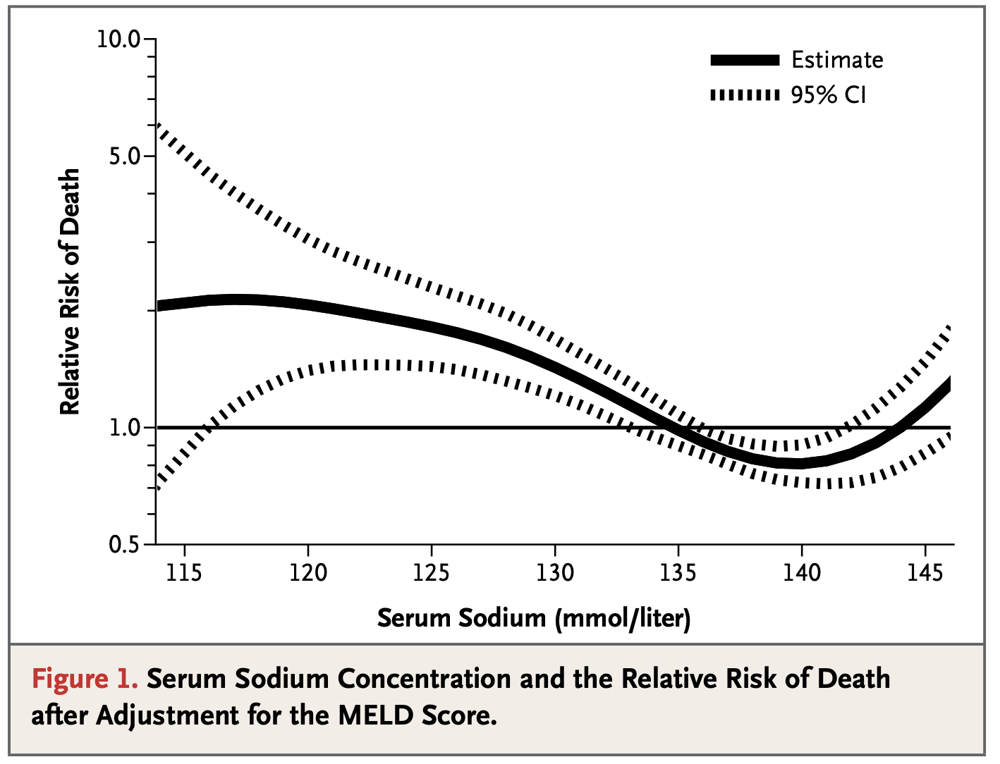
N Engl J Med 2008;359:1018-26.

Slide 18
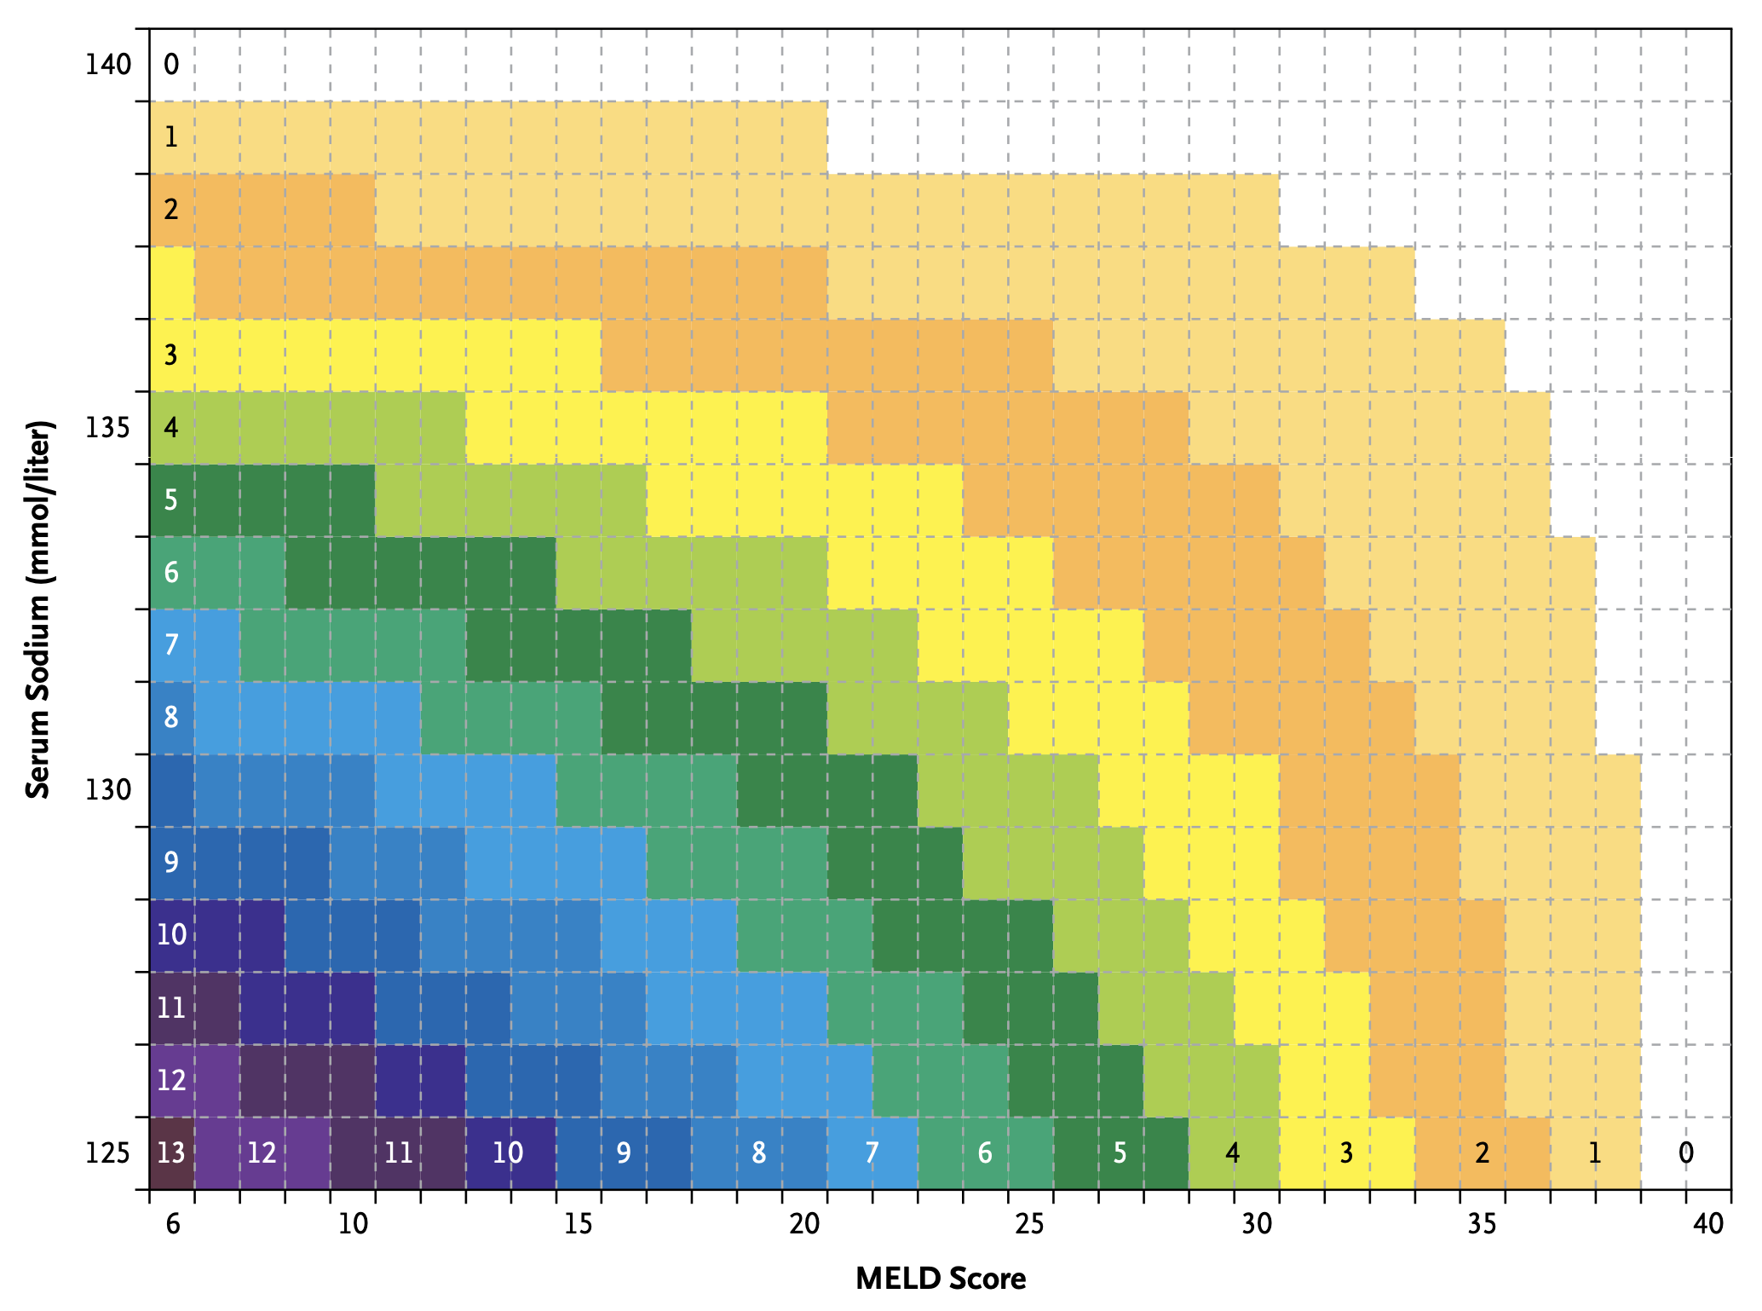
N Engl J Med 2008;359:1018-26.

Slide 19
Diagnosis of Hyponatremia

Slide 20
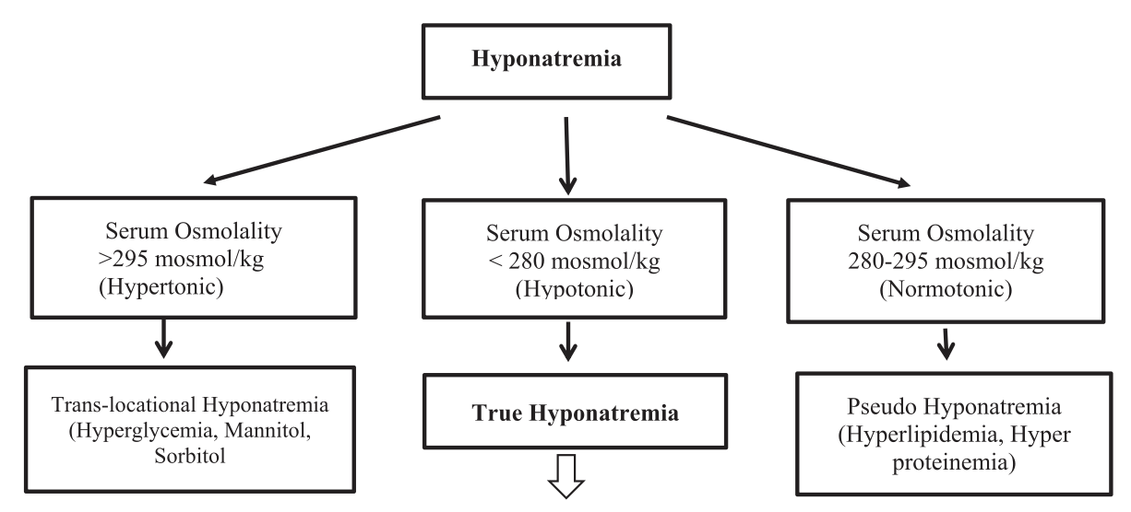
Alukal JJ, John S, Thuluvath PJ. Hyponatremia in Cirrhosis: An Update. Am J Gastroenterol. 2020 Nov;115(11):1775-1785

Slide 21
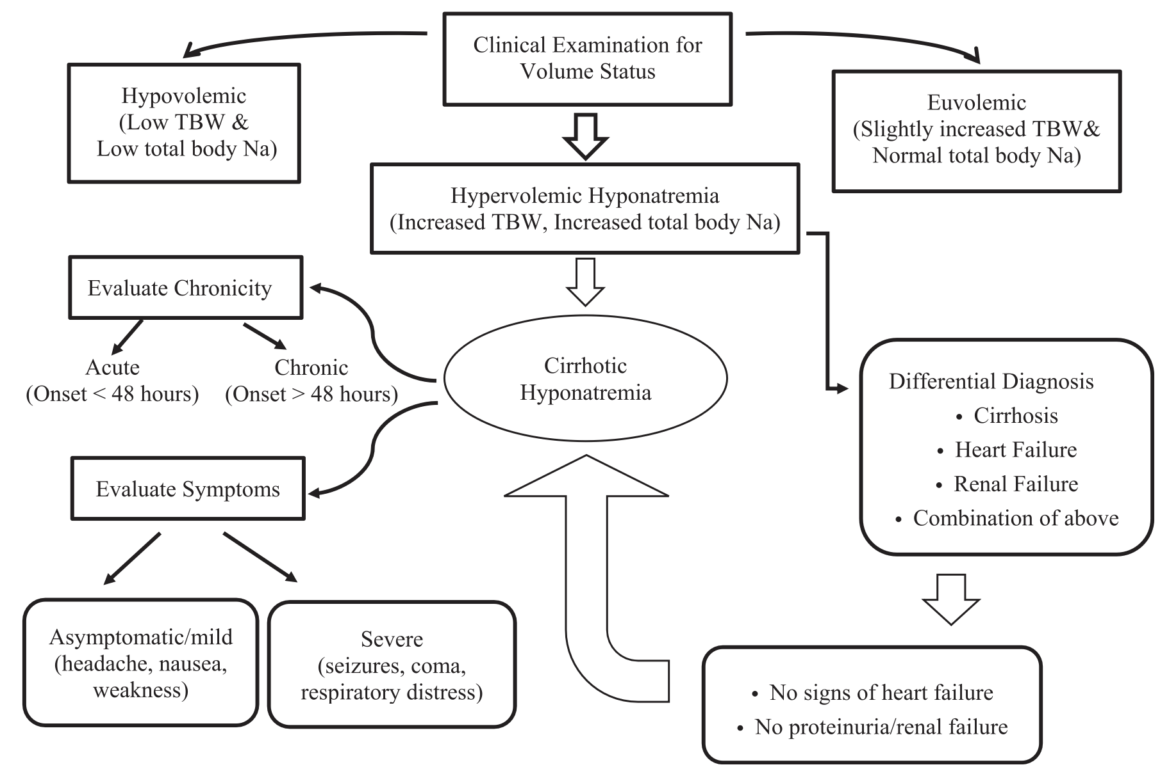
Alukal JJ, John S, Thuluvath PJ. Hyponatremia in Cirrhosis: An Update. Am J Gastroenterol. 2020 Nov;115(11):1775-1785

Slide 22
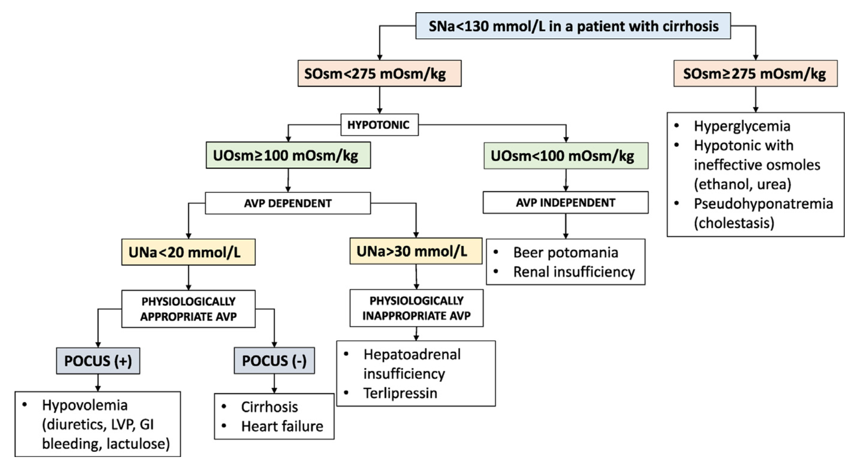
Rondon-Berrios H, Velez JCQ. Hyponatremia in Cirrhosis. Clin Liver Dis. 2022 May;26(2):149-164

Slide 23
Treatment and Challenges

Slide 24
Points to Remember
“There are no data that increasing the serum sodium concentration in patients with cirrhosis improves morbidity or mortality.”
“Daily correction by more than 6 to 8 mEq/L should be avoided to minimize the risk of osmotic demyelination syndrome”

Slide 25
Let’s talk about what to avoid?

Slide 26
Therapies to Avoid
Fluid restriction!?
Vasopressin receptor antagonist in non-transplant setting
Demeclocycline

Slide 27
Fluid Restriction
This is not supported by data or evidence
Tends to alienate and restrict patient, cohabitants, nurses, and dietitians
The systemic vasodilation that stimulates AVP/ADH, also stimulates thirst!
It may work if and only if:
Total fluid intake < total urine volume
May be trialed for 48 hours, if no correction = failed

Slide 28
Vasopressin receptor antagonist

Slide 29
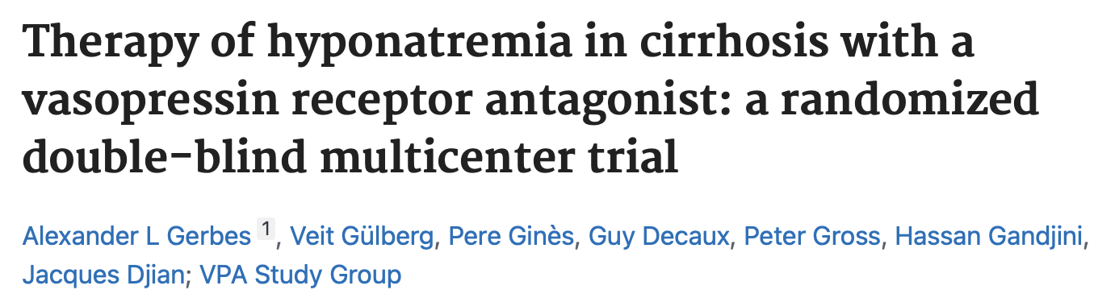
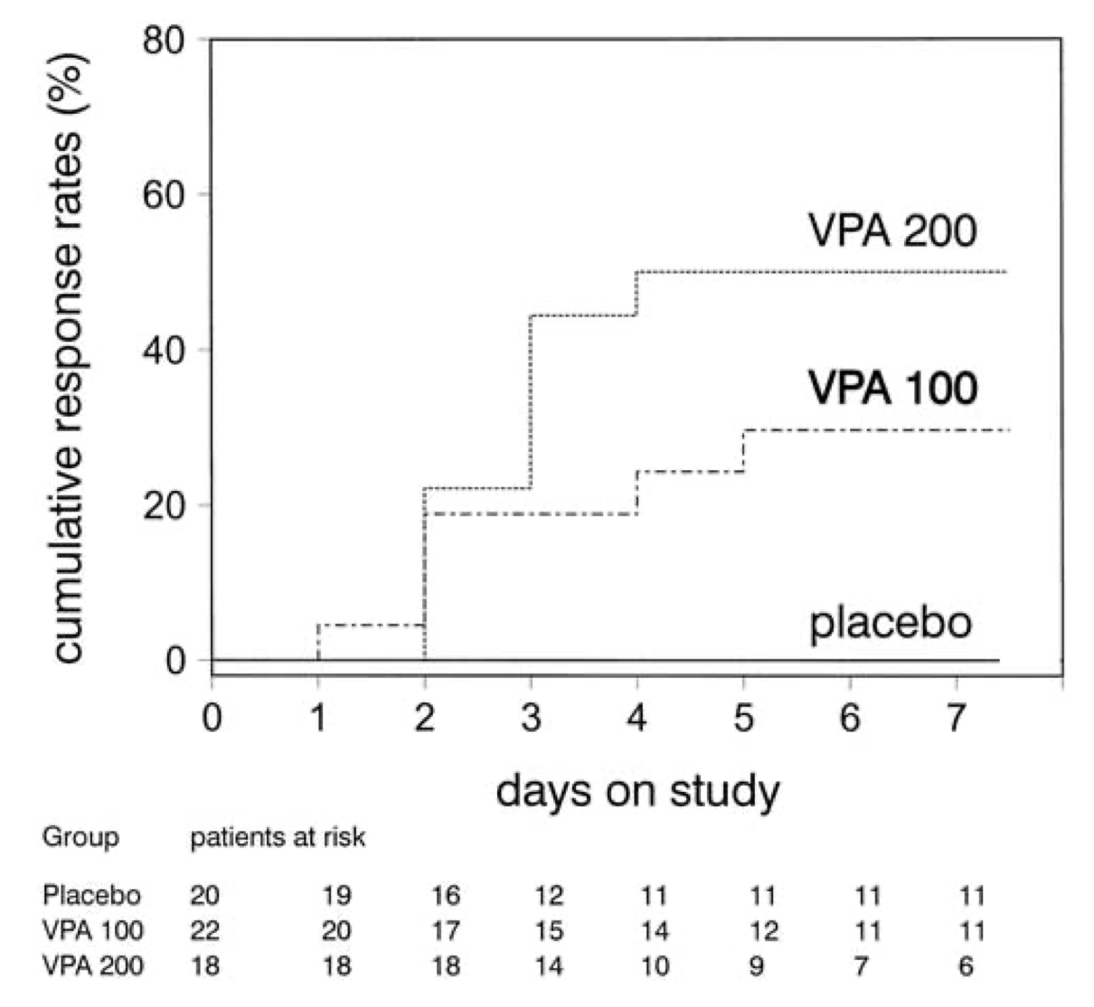
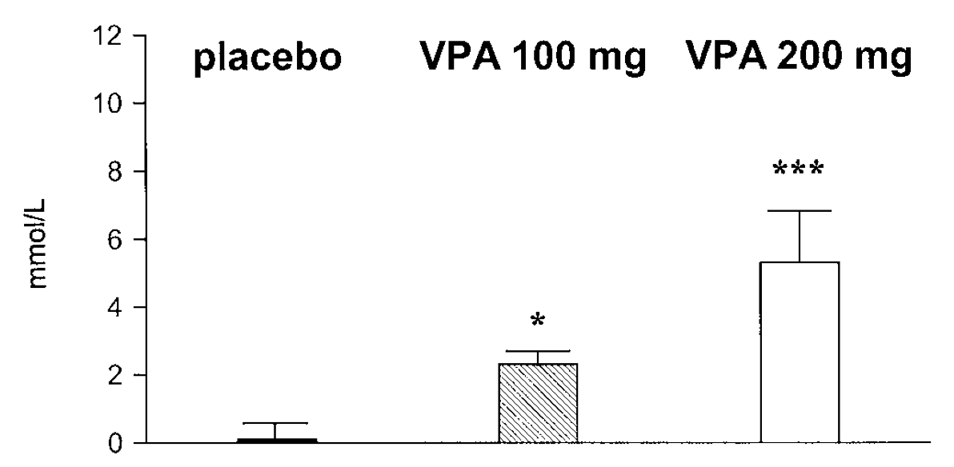
N=60
Gastroenterology. 2003 Apr;124(4):933-9

Slide 30
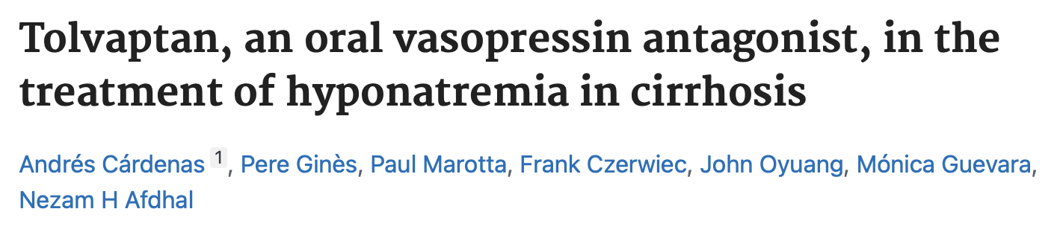
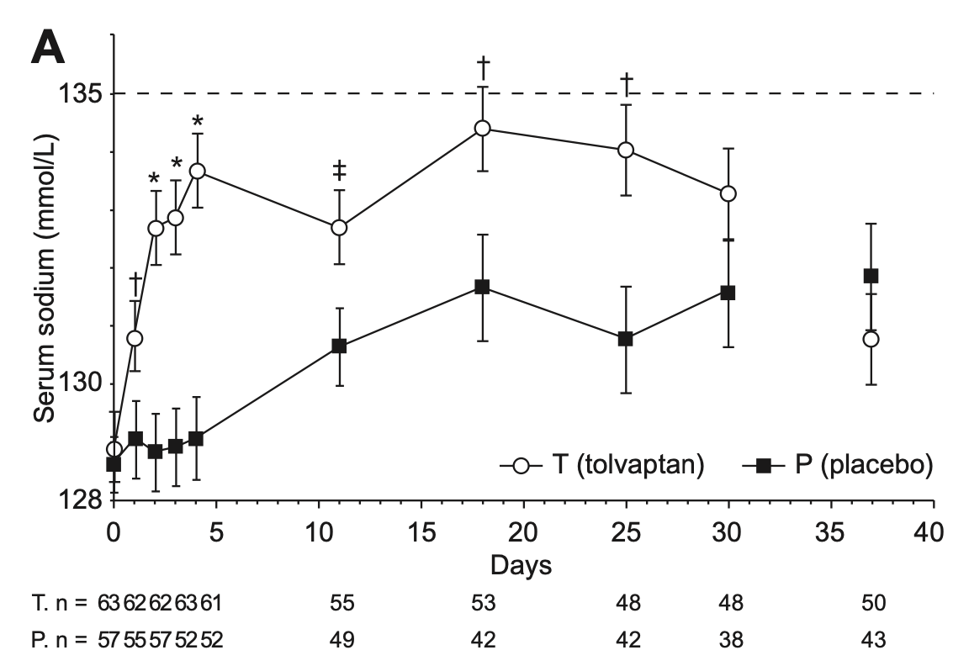
N=120
J Hepatol. 2012 Mar;56(3):571-8

Slide 31
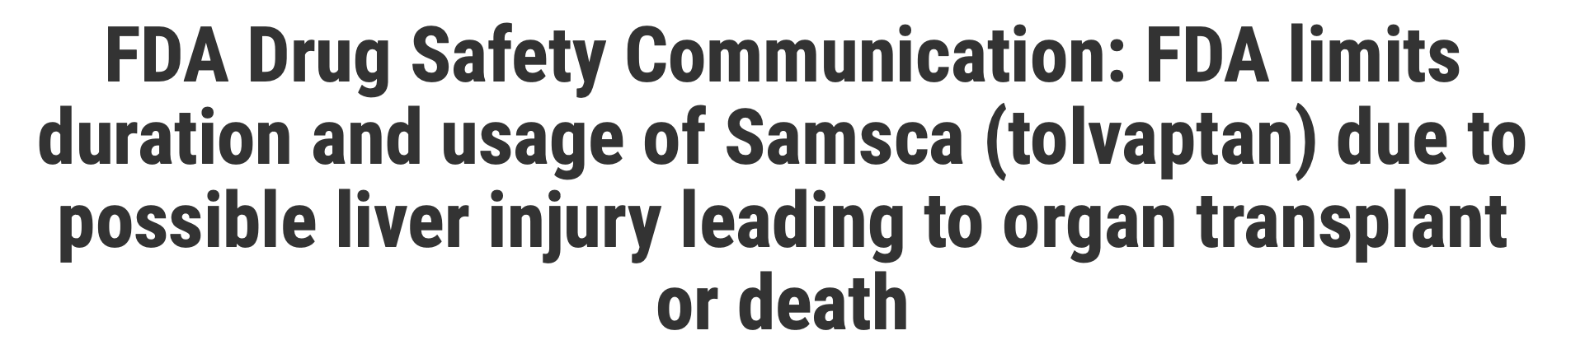
Tolvaptan-Induced Liver Injury
Tolvaptan Efficacy and Safety in Management of Autosomal Dominant Polycystic Kidney Disease and Its Outcomes [TEMPO] 3:4) RCT that examined its effect on the progression of kidney disease in ADPKD
>2.5-fold increase in liver enzymes in tolvaptan vs placebo
The serious liver injury cases observed were consistent with Hy's law
[04-30-2013]

Slide 32
Tolvaptan in Liver Transplantation
Despite FDA warning, a reasonable exception to using tolvaptan would be in patients who are awaiting imminent liver transplantation
Should still be avoided in acute hepatitis

Slide 33
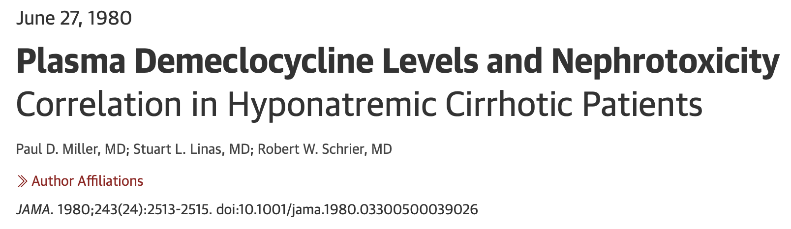
Demeclocycline
Tetracycline that is a partial antagonist to AVP/ADH
Nephrotoxic and should be avoided in cirrhosis

Slide 34
Management of Hyponatremia in Cirrhosis

Slide 35
Verbeek TA, Saner FH, Bezinover D. Hyponatremia and Liver Transplantation: A Narrative Review. J Cardiothorac Vasc Anesth. 2022 May;36(5):1458-1466

Slide 36
Stepwise Approach
Withdraw iatrogenic factors
  Stop NSBB/Diuretics/AntiHTN
  MAP > 82 or BP > 90/60; don’t let MAP < 65
Correct hypokalemia
  Potassium enters the cells.
  Intracellular sodium moves to the extracellular space to maintain cell electroneutrality.
  Chloride moves into cells along with potassium -> Free water enters the cells.
  Intracellular hydrogen moves to the extracellular space -> Hydrogen is buffered by bicarbonate -> Extracellular osmolality decreases.
Treat with midodrine to increase MAP

Slide 37
Therapy for Severe Hyponatremia
Albumin infusion
Hypertonic saline + diuresis/paracentesis
Hemodialysis

Slide 38
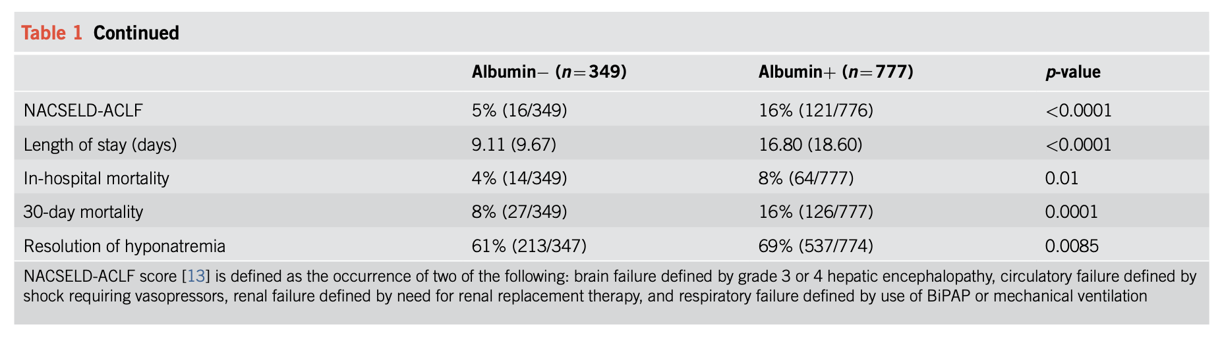
Albumin Infusions
Can be used 1g/kg/day (max 100 g) until resolution of severe hyponatremia
One retrospective trial showed resolution of hyponatremia when albumin was used
Bajaj et al. The Impact of Albumin Use on Resolution of Hyponatremia in Hospitalized Patients With Cirrhosis. Am J Gastroenterol. 2018 Sep;113(9):1339

Slide 39
Hypertonic Saline
This may be an initial therapy for patients with severe symptomatic hyponatremia
May be used pre-transplantation to raise the sodium to safe levels
Adjuvant therapy to hypertonic saline
  Loop diuretics (NOT thiazides)
  Large-volume paracentesis

Slide 40
Hemodialysis
Reserved to patients who have severe kidney function impairment
  GFR < 15 mL/min/1.73m2
Those who are candidates for liver transplantation
Can be challenging due to hemodynamic instability
Use low-sodium dialysate (130 mEq/L Na) to avoid rapid correction
  Use of D5W may be required to avoid correction > 8 mEq/L/24h

Slide 41
Hyponatremia Management
Fluid Restriction
Tolvaptan
Stop: BB, diuretics, antihypertensives
Correct hypoK
Midodrine
Albumin
Hypertonic saline
Hemodialysis

Slide 42
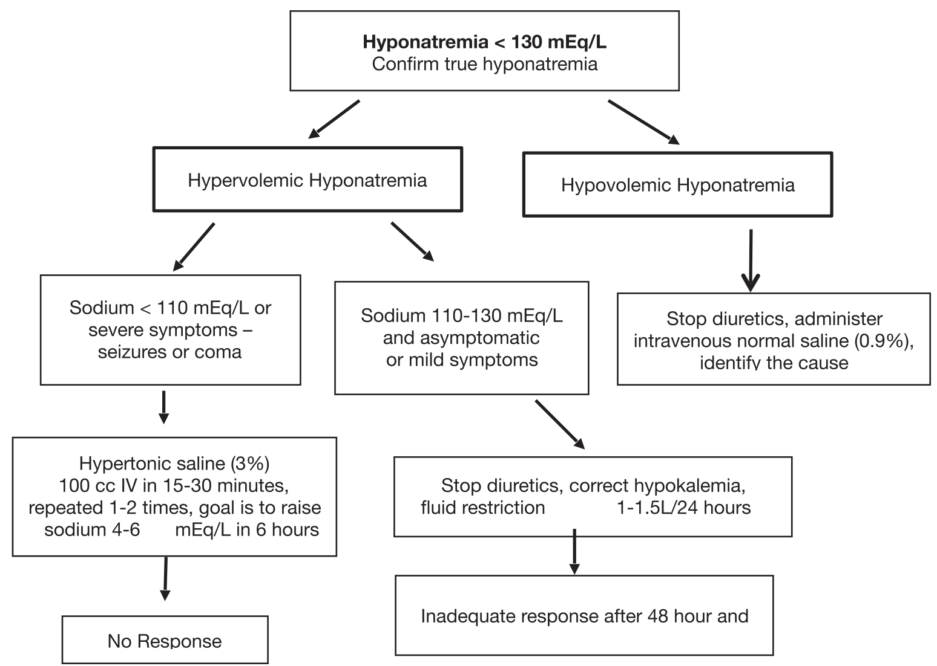
Alukal JJ, John S, Thuluvath PJ. Hyponatremia in Cirrhosis: An Update. Am J Gastroenterol. 2020 Nov;115(11):1775-1785

Slide 43
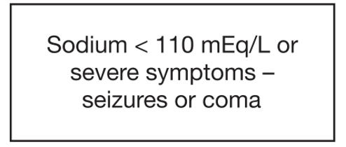
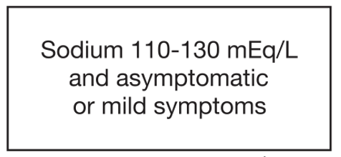
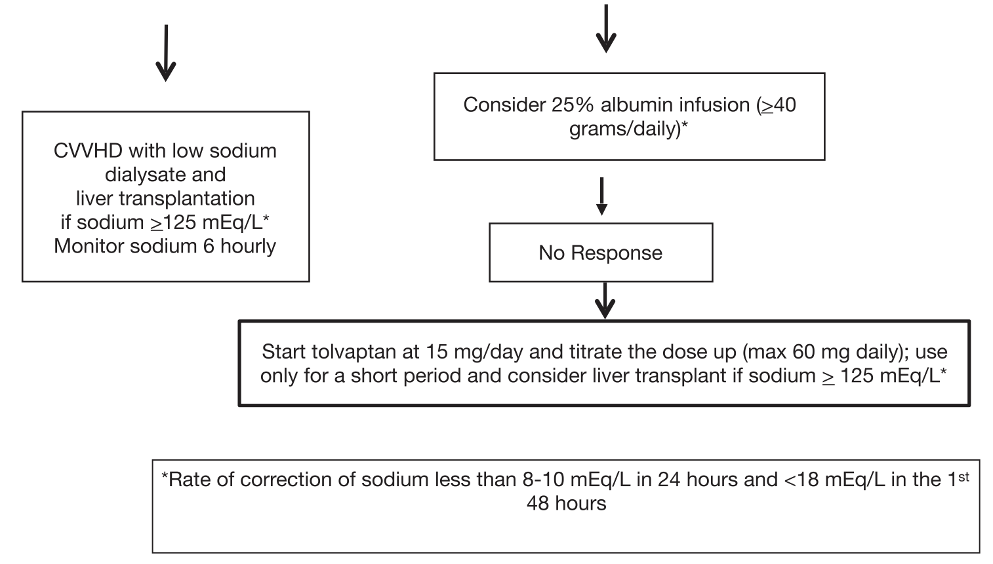
Alukal JJ, John S, Thuluvath PJ. Hyponatremia in Cirrhosis: An Update. Am J Gastroenterol. 2020 Nov;115(11):1775-1785

Slide 44
Hyponatremia in Context of Liver Transplant

Slide 45
Liver Transplant Outcomes in Hyponatremics
Early reports regarding patients with pre-LT hyponatremia demonstrated increased morbidity after LT
  Longer ICU stays, increased risk of neurologic complications, renal failure, infection, and prolonged hospital time

Slide 46
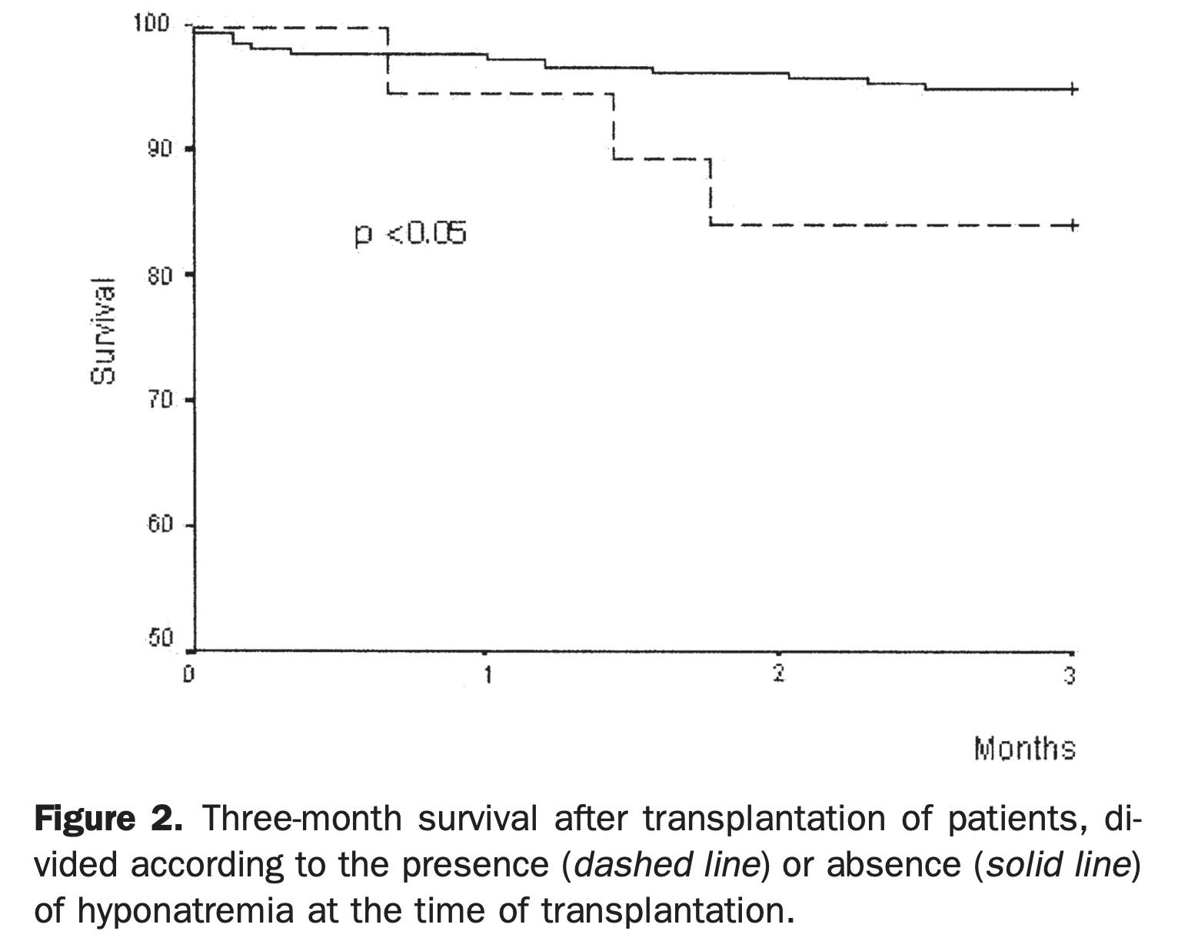
Retrospective cohort
N=241
Londoño et al. Hyponatremia impairs early posttransplantation outcome in patients with cirrhosis undergoing liver transplantation. Gastroenterology. 2006 Apr;130(4):1135-43.

Slide 47
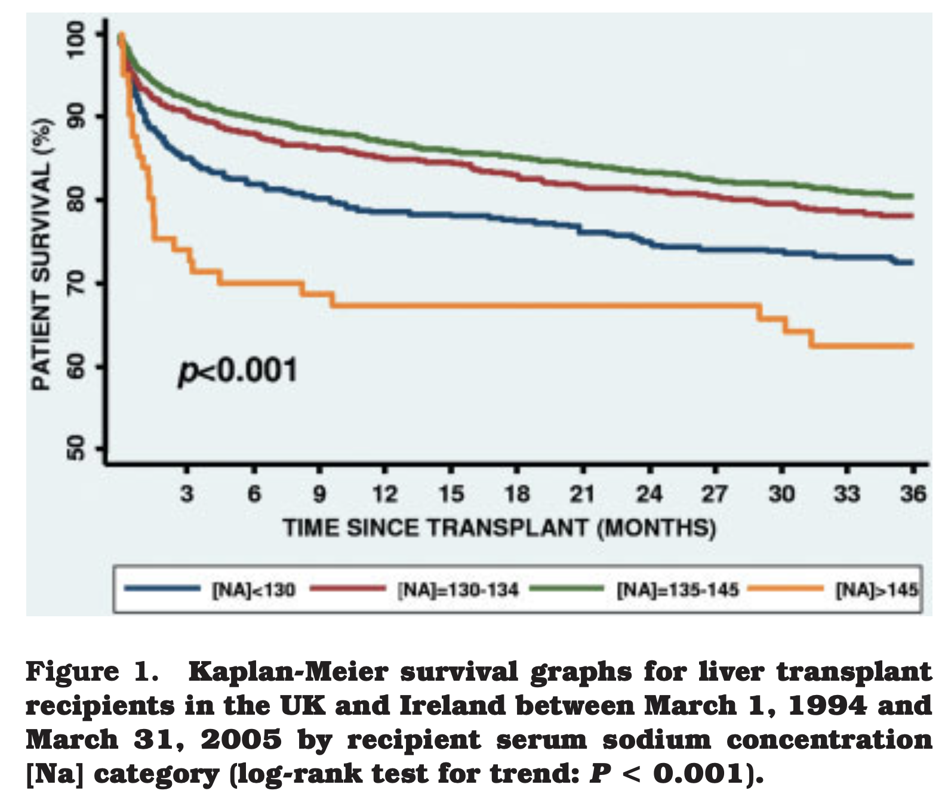
Retrospective Cohort
N=5,152
Dawwas et al. The impact of serum sodium concentration on mortality after liver transplantation: a cohort multicenter study. Liver Transpl. 2007 Aug;13(8):1115-24

Slide 48
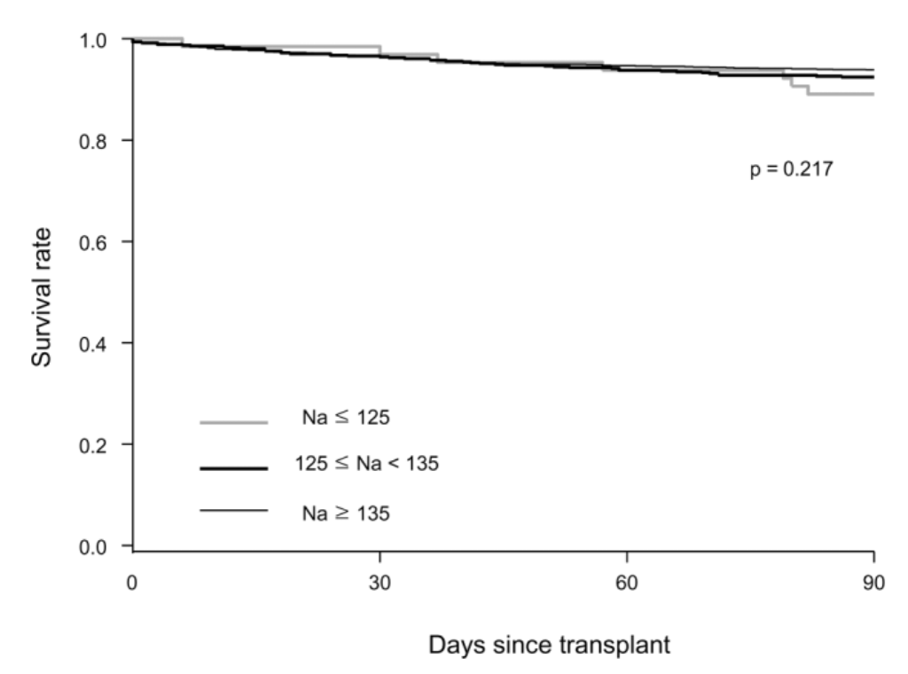
Retrospective Cohort
N=2,175
Yun et al. Impact of pretransplant hyponatremia on outcome following liver transplantation. Hepatology. 2009 May;49(5):1610-5

Slide 49
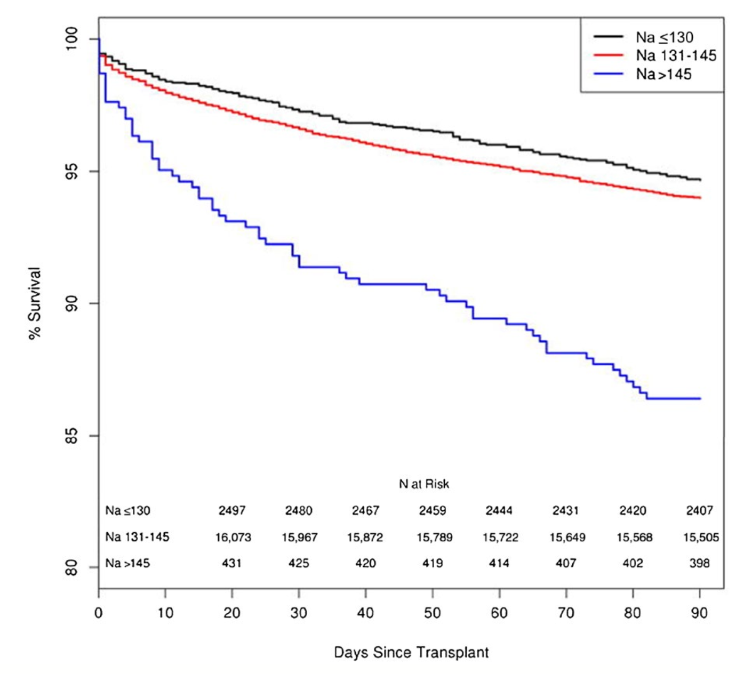
Retrospective Cohort
N=19,537
Leise et al. Effect of the pretransplant serum sodium concentration on outcomes following liver transplantation.
Liver Transpl. 2014 Jun;20(6):687-97

Slide 50
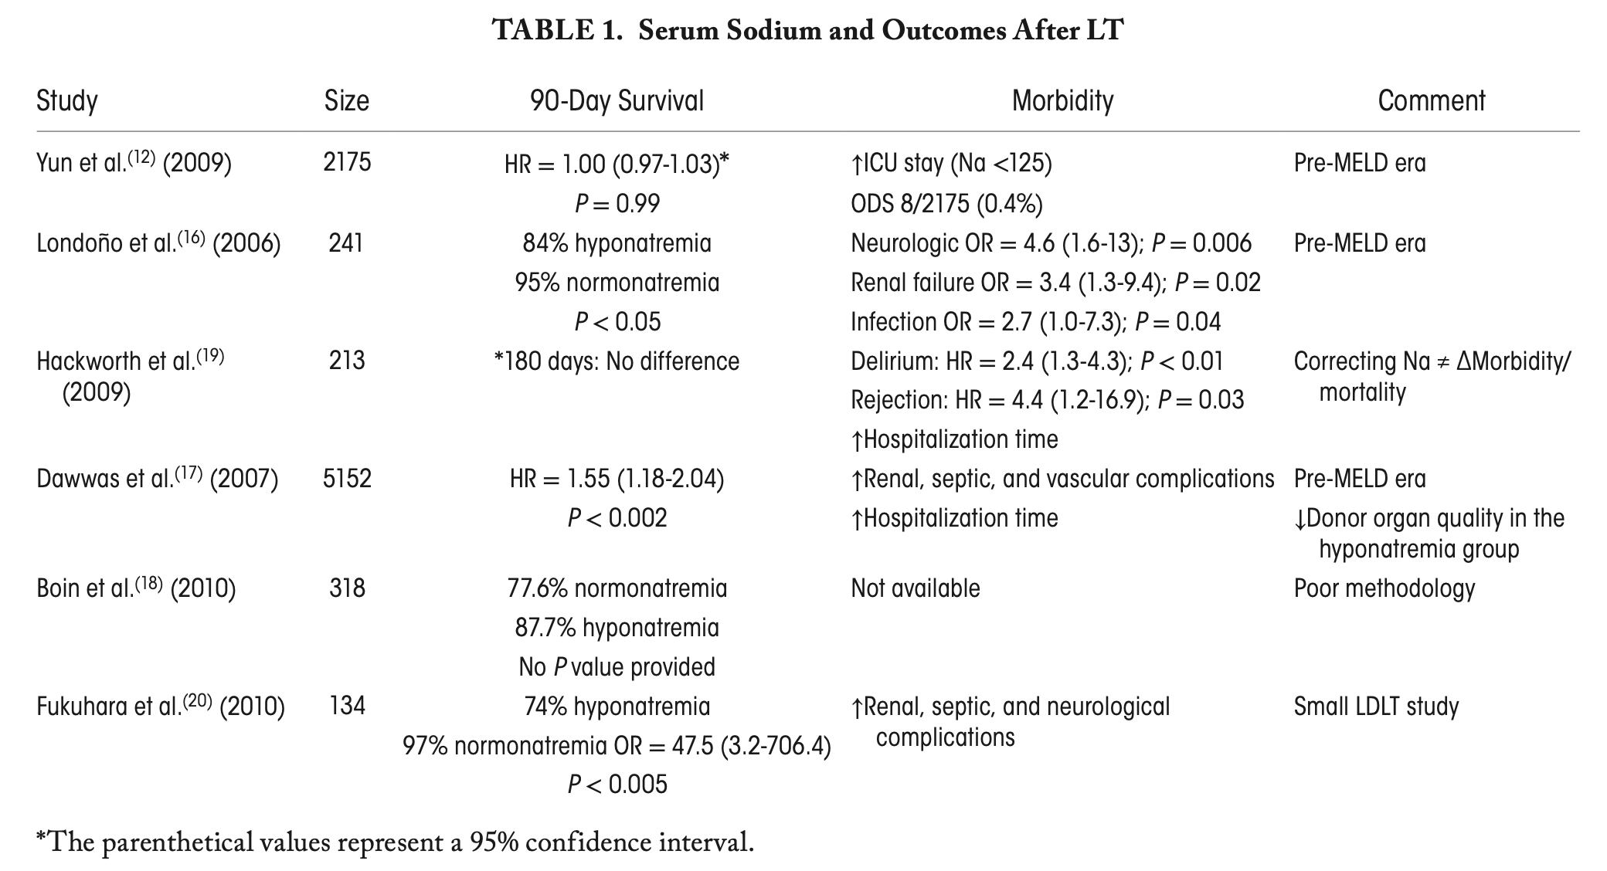
Leise M, Cárdenas A. Hyponatremia in Cirrhosis: Implications for Liver Transplantation. Liver Transpl. 2018 Nov;24(11):1612-1621

Slide 51
Rapid correction of hyponatremia

Slide 52
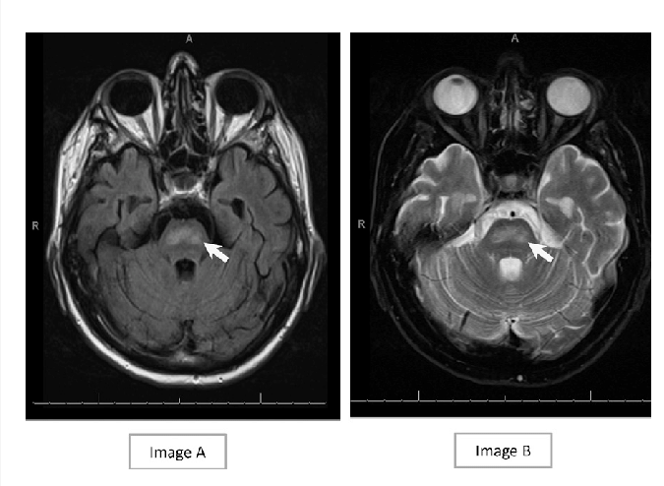

Slide 53
Osmotic Demyelination Syndrome (ODS)
Formerly called “Central Pontine Demyelinolysis”
Correction of hyponatremia of > 8 mEq/L in 24 hours
Clinically variable, but ranges from neurologic deficits (dysarthria, paralysis) to “locked in syndrome” and coma
Presents 2-6 days after overcorrection of hyponatremia
  But can present multiple weeks liver transplant!
Incidence post-liver transplant ranges from 0.5% to 1.5%

Slide 54
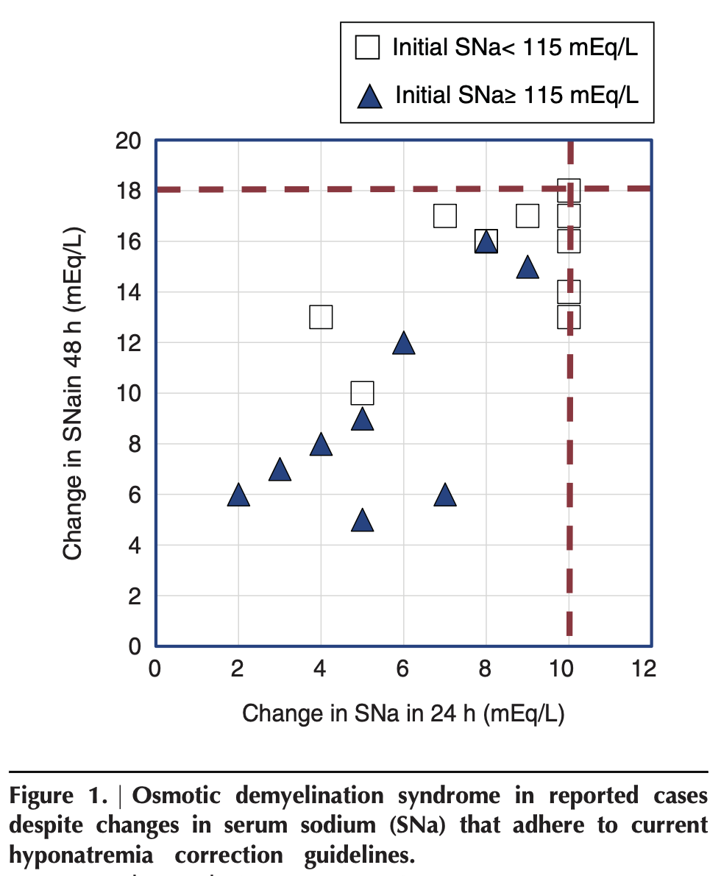
Tandukar et al. Osmotic Demyelination Syndrome following Correction of Hyponatremia by ≤10 mEq/L per Day. Kidney360. 2021 Jul 8;2(9):1415-1423

Slide 55
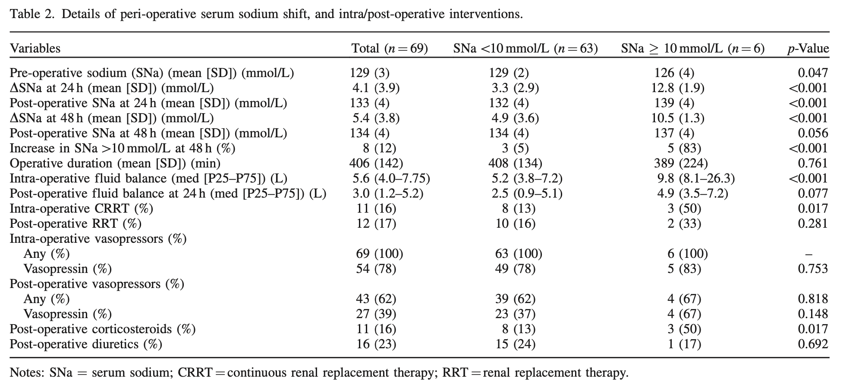
Intraoperative Risk Factors for Overcorrection
Romanovsky et al. Serum sodium shift in hyponatremic patients undergoing liver transplantation: a retrospective cohort study. Ren Fail. 2015 Feb;37(1):37-44

Slide 56
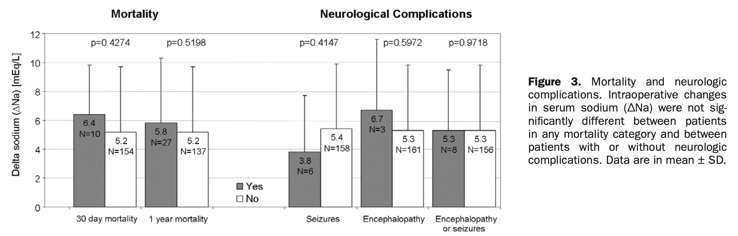
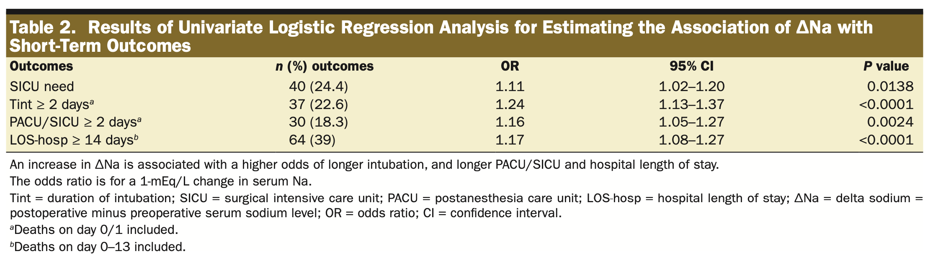
N=165
Hudcova et al. Sodium homeostasis during liver transplantation and correlation with outcomes. Anesth Analg. 2014 Dec;119(6):1420-8

Slide 57
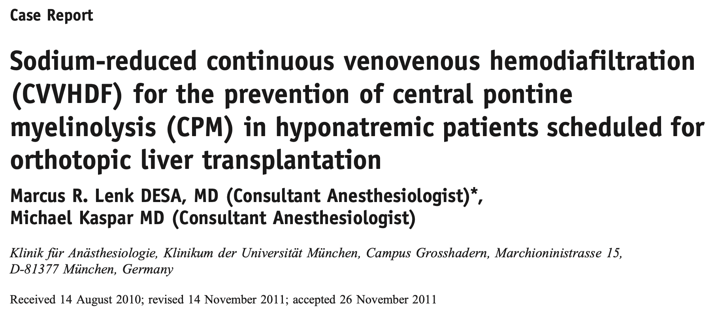
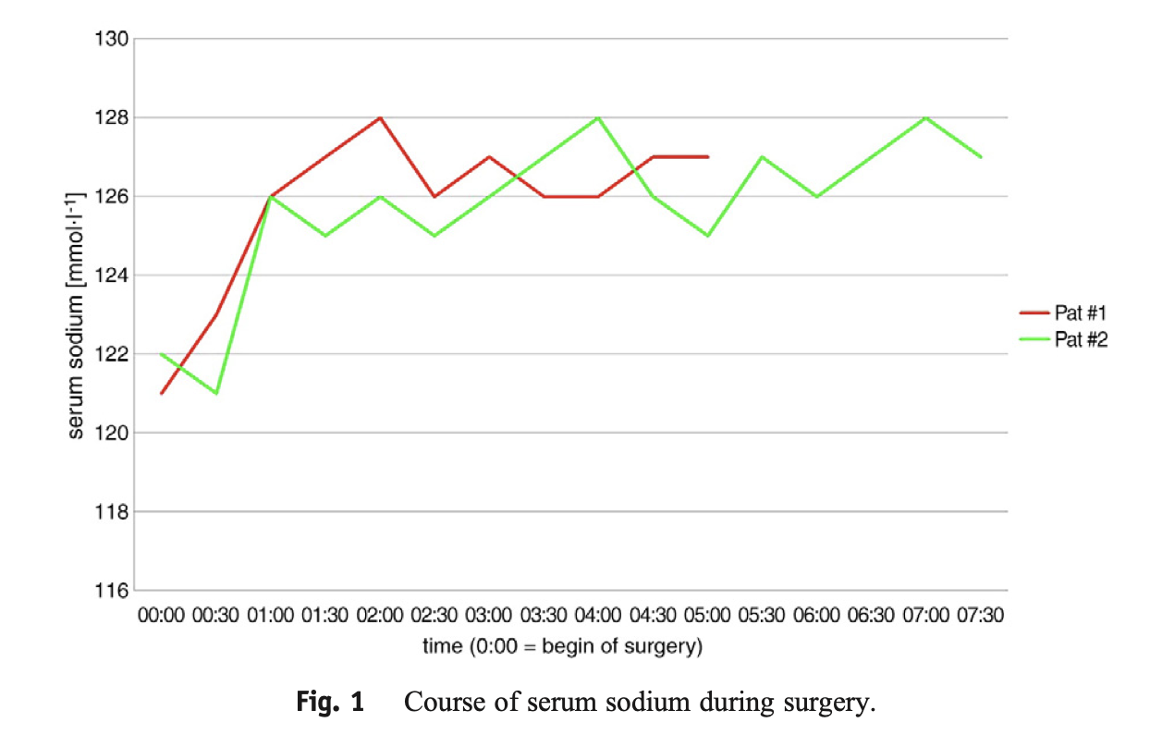

Slide 58
No Standard of Care Between Transplant Centers
Only 2 out of 20 surveyed LT programs had a standard intraoperative hyponatremia management protocol
>99% of liver transplant recipients had Na > 120
0.2-0.49% had Na < 120
Perioperative management was variable between all programs
Leise M, Cárdenas A. Hyponatremia in Cirrhosis: Implications for Liver Transplantation. Liver Transpl. 2018 Nov;24(11):1612-1621

Slide 59
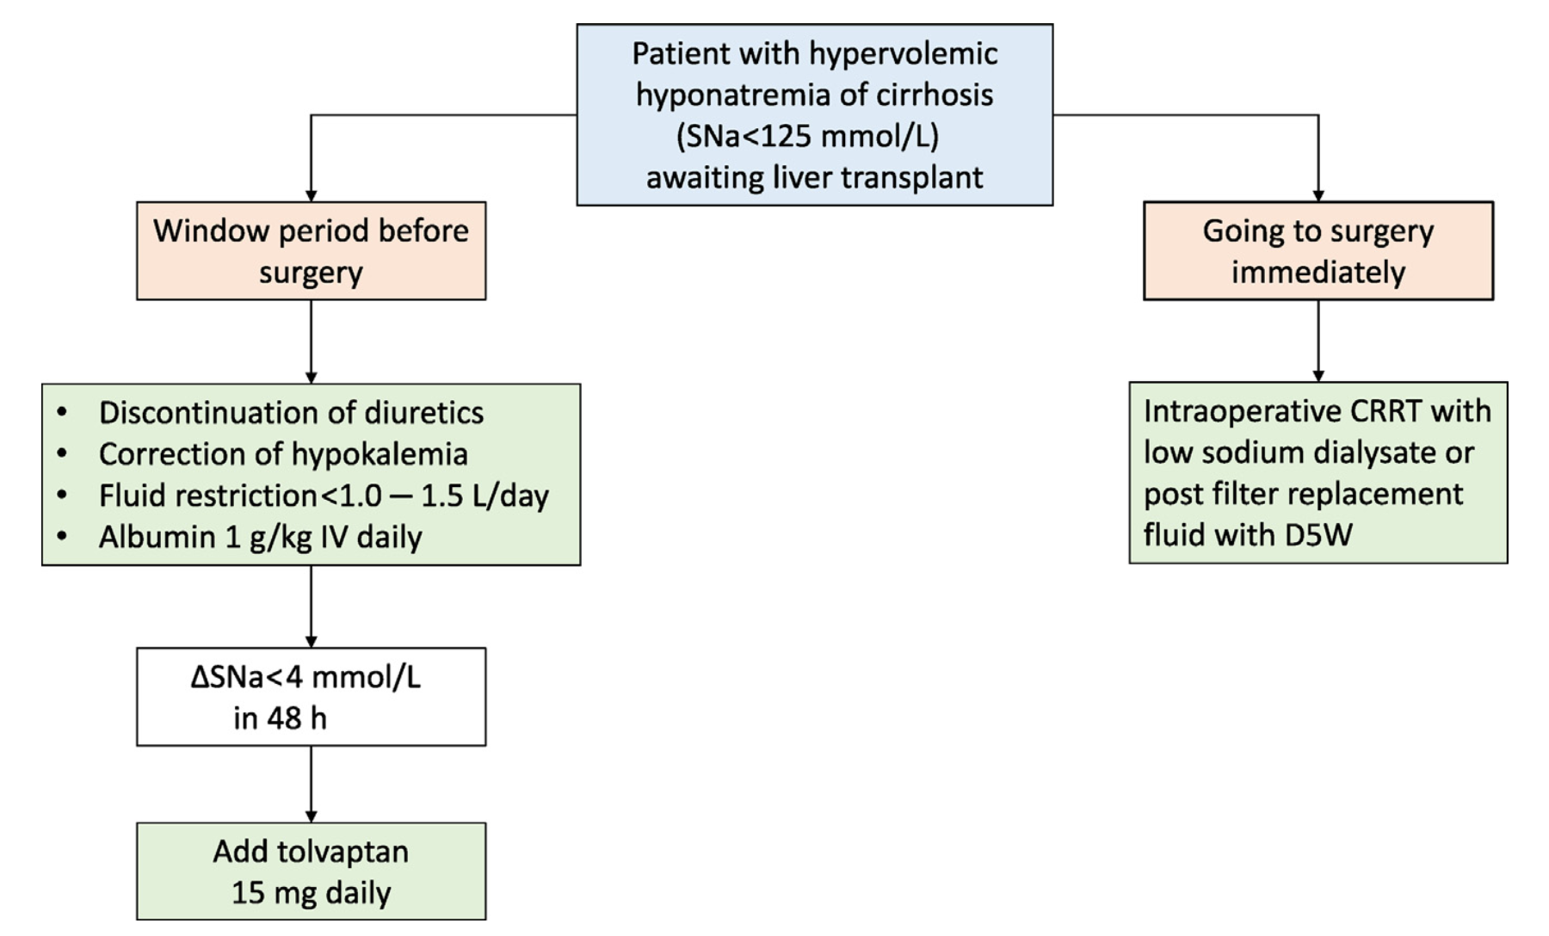
Rondon-Berrios H, Velez JCQ. Hyponatremia in Cirrhosis. Clin Liver Dis. 2022 May;26(2):149-164

Slide 60
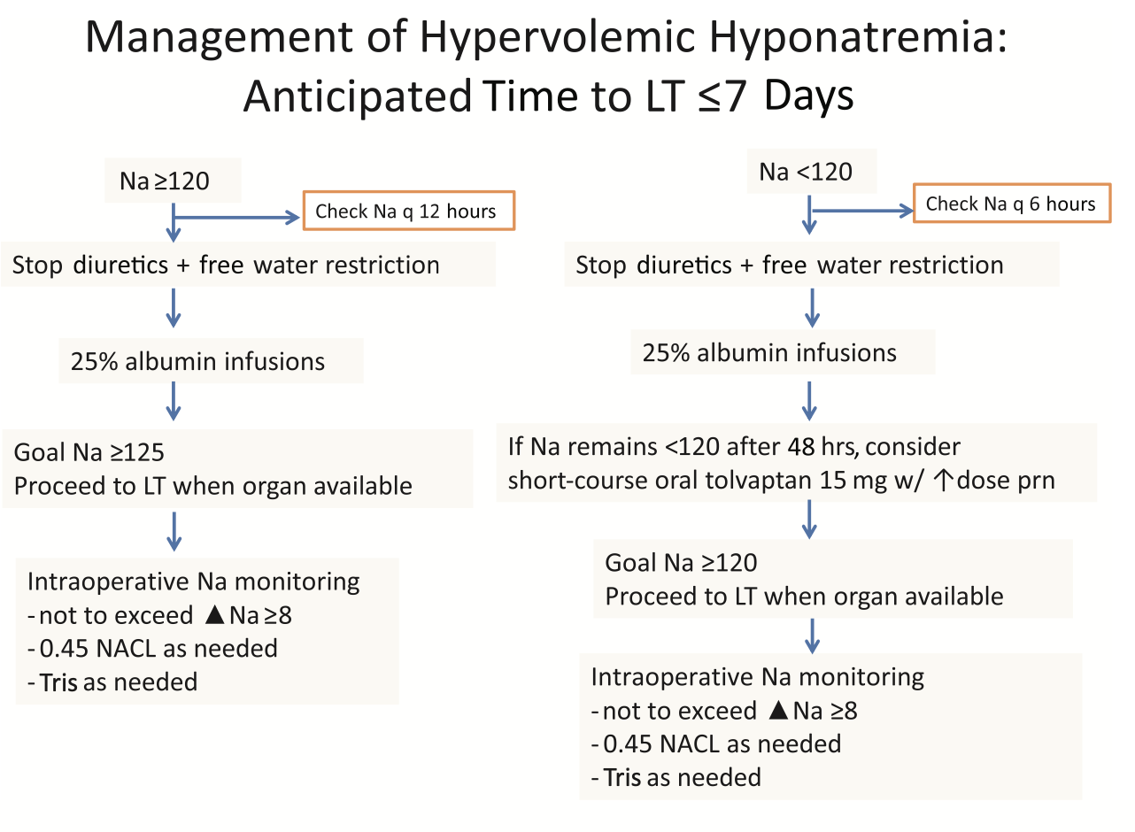
Leise M, Cárdenas A. Hyponatremia in Cirrhosis: Implications for Liver Transplantation. Liver Transpl. 2018 Nov;24(11):1612-1621

Slide 61
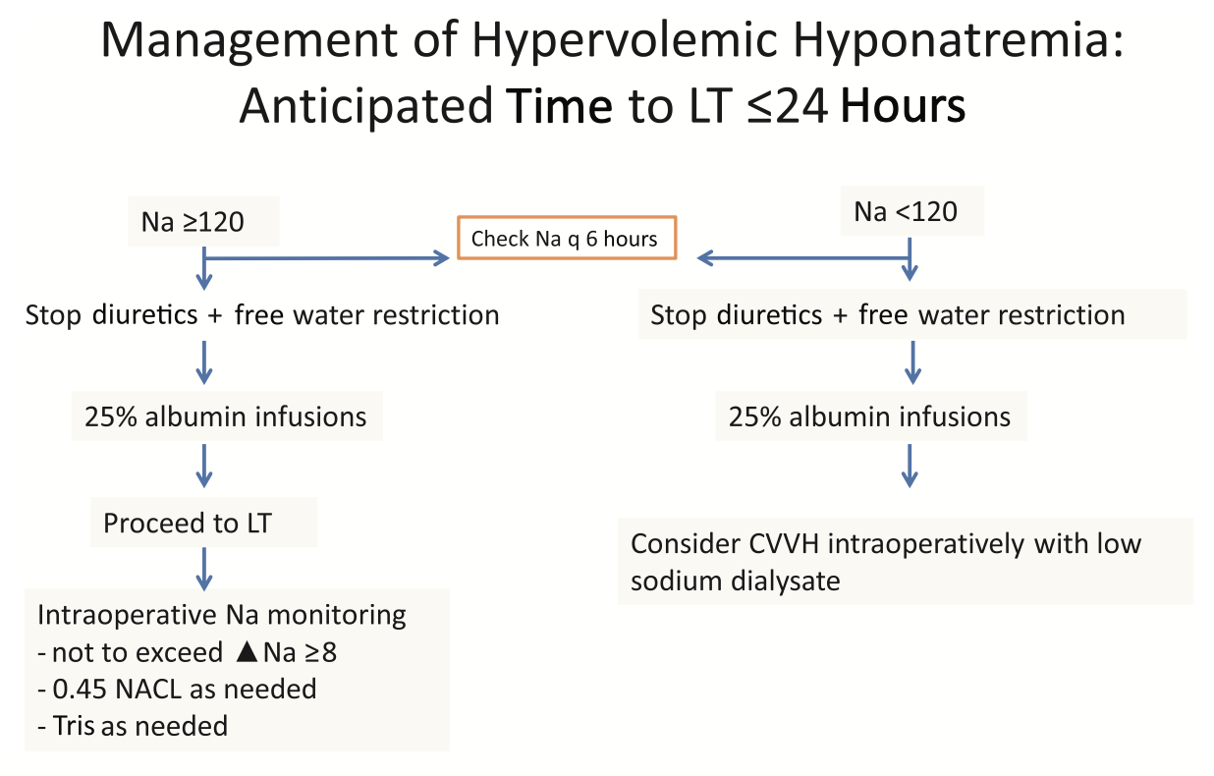
Leise M, Cárdenas A. Hyponatremia in Cirrhosis: Implications for Liver Transplantation. Liver Transpl. 2018 Nov;24(11):1612-1621

Slide 62
Take-Home Points
Hyponatremia in cirrhotics is mainly vasopressin/ADH-driven
  Focus is on preventing this insult
Avoid rapid overcorrection of hypoNa >8 mEq/L/24 hours
ODS can present late (even weeks later)
Fluid restriction is worth the attempt, but probably won’t work
Tolvaptan only for LT candidates
If RRT to be used -> low dialysate sodium (130 mEq/L)
No real “contraindicated” sodium level

